Slide 1
Mediator Design Pattern
Shahd Osman
CS665 final Project

Slide 2
Problem
We want to design reusable components, but dependencies between the potentially reusable pieces demonstrates the "spaghetti code" phenomenon
There are too many relationships between the objects in your code.

Slide 3
Solution
Define an object that encapsulates how a set of objects interact. Mediator promotes loose coupling by keeping objects from referring to each other explicitly, and it lets you vary their interaction independently.
Promote the many-to-many relationships between interacting peers to "full object status".

Slide 4
description
The Mediator pattern is known as a behavioural pattern, as it's used to manage algorithms, relationships and responsibilities between objects
The Mediator defines an object that controls how a set of objects interact. Loose coupling between colleague objects is achieved by having colleagues communicate with the Mediator, rather than with each other.

Slide 5
UML

Slide 6
Mediator :It defines the interface for communication between colleague objects.
ConcreteMediator : It implements the mediator interface and coordinates communication between colleague objects.
Colleague : It defines the interface for communication with other colleagues
ConcreteColleague : It implements the colleague interface and communicates with other colleagues through its mediator

Slide 7
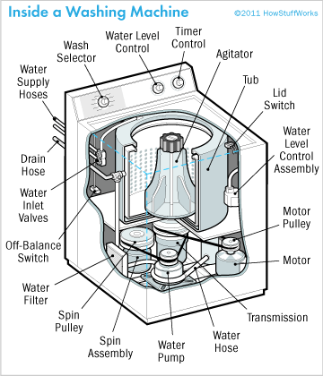
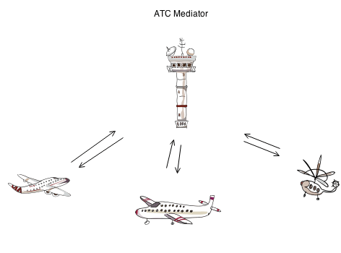
Example
Uber system
flight simulator
Fully automatic washing machine (code example)

Slide 8
Downsides
While this pattern aims to reduce complexity, without proper design, the Mediator object itself can become very complicated itself. The Observer pattern could help here, with the colleague objects dealing with the events from the mediator, rather than having the mediator look after all orchestration.

Slide 9
Look like facade!
Mediator is similar to Facade in that it abstracts functionality of existing classes. Mediator abstracts/centralizes arbitrary communication between colleague objects, it routinely "adds value", and it is known/referenced by the colleague objects (i.e. it defines a multidirectional protocol).
In contrast, Facade defines a simpler interface to a subsystem, it doesn't add new functionality, and it is not known by the subsystem classes (i.e. it defines a unidirectional protocol where it makes requests of the subsystem classes but not vice versa).

Slide 10
refrences
Design Patterns: Elements of Reusable Object‐Oriented Software By Erich Gamma, Richard Helm, Ralph Johnson and John Vlissides Addison‐Wesley,1994
https://www.geeksforgeeks.org/mediator-design-pattern/
https://dzone.com/articles/design-patterns-mediator
http://www.design-patterns-stories.com/patterns/Mediator/

